Slide 1
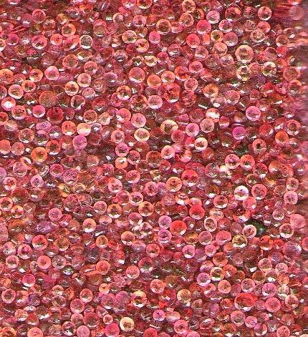
Object-oriented Programming with Ruby
Robert Batzinger
CSCI A-201
Spring 2009

Slide 2
Working with Shoes:
Creating graphical programs

Slide 3
Topics to be covered
Installing and running Shoes
Setting up the application
Graphic objects
Animating objects
Input objects
Interfacing with other classes

Slide 4
Why Shoes?
Shoes is a cross-platform gui that runs Ruby 1.8.6
It is free
The commands are Ruby classes which are easy to use
Unlike other gui alternatives for Ruby, only the Shoes download is required. (No other module needs to be downloaded and installed).
Supports input objects, graphics and animation.

Slide 5

Installing Shoes
Available from http://shoooes.net
Select and download the runtime versions for your computer (Mac OsX, MS Windows and Linux versions available)
Documentation and tutorial comes with the compiler
(May require you to drag and drop the program into a folder) Follow the installation instructions for your OS

Slide 6
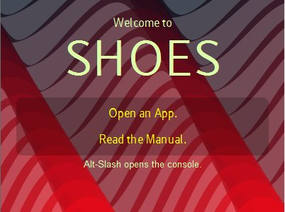
Running Shoes
Type your Ruby code in a text file with an .rb extension
Activate the Shoes control panel
Select your program

Slide 7
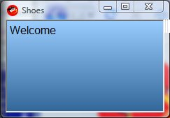
Setting up the application
Shoes.app do
background "#9CF".."#369"
para "Welcome"
end
Shoes programs are actually graphic applications.
Much of this code is common to all shoes programs
There are many styles that can applied to this

Slide 8
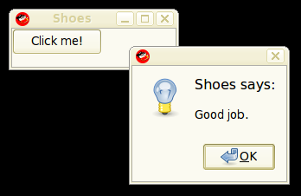
Graphic objects
Shoes supports objects with event handlers for
Arrow:draws an arrow object
Background : color/image behind the application
Border : around the application
Image : displays a graphic
Oval: draws an oval or circle
Line: draws a line
Progress : a sliding bar progress graphic
Rect: draws a rectangle
Shape : element to drawlines
Star: draws a star with N points
Video: video display viewer
Shoes.app {
button("Click me!") {
alert("Good job.")
}
}

Slide 9
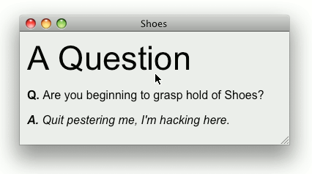
Text objects
Shoes.app {
stack(:margin => 6) {
title "A Question"
para strong("Q."),
" Are you beginning to grasp hold of Shoes?“
para em(strong("A."),
" Quit pestering me, I'm hacking here.")
}
Para
Banner
Caption
Para
Subtitle
Tagline
Title

Slide 10
Animating objects
Shoes.app do
@text = para "START“
animate(24) do |frm|
@text.replace
"FRAME #{frm}"
end
end
Animation is achieved by changing attributes of elements
The frequency of an animated block can be varied

Slide 11
Input objects
Button : click button
Check : checkbox for multiple choices
EditBox : multiline editor
EditLine : single text line editor
Image : displays a graphic
ListBox : displays a drop down list
Radio : radio button choice selector
TextBlock : displayed text
Timers : clock timers
Values of inputs and displays are attributes of the object
Changing the attributes will change the change the values
Accessing the attributes will read the values

Slide 12
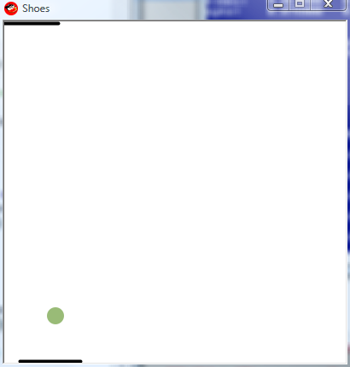
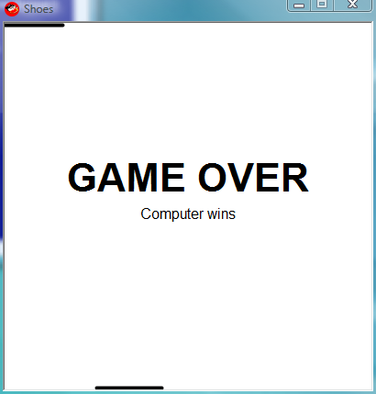
Pong: An example
Pong written in Shoes
Uses mouse to control paddle
Changes the attributes of the objects
Animation changes the position

Slide 13
Pong
Shoes.app :width => 400, :height => 400, :resizable => false do
paddle_size = 75
ball_diameter = 20
vx, vy = [3, 4]
compuspeed = 10
bounce = 1.2
@ball = oval 0, 0, ball_diameter, :fill => "#9B7"
@you, @comp = [app.height-4, 0].map {|y|
rect 0, y, paddle_size, 4, :curve => 2}

Slide 14
Pong 2
@anim = animate 40 do
if @ball.top + ball_diameter < 0 or
@ball.top > app.height
para strong("GAME OVER", :size => 32), "\n",
@ball.top < 0 ? "You win!" : "Computer wins", :top => 140, :align => 'center'
@ball.hide and @anim.stop
end

Slide 15
Pong 3
@you.left = mouse[1] - (paddle_size / 2)
nx, ny = (@ball.left + vx).to_i, (@ball.top + vy).to_i
@comp.left +=
if nx + (ball_diameter / 2) > @comp.left + paddle_size; compuspeed
elsif nx < @comp.left; -compuspeed
else 0 end
if ny + ball_diameter > app.height and vy > 0 and
(0..paddle_size).include? nx + (ball_diameter / 2) - @you.left
vx, vy = (nx - @you.left - (paddle_size / 2)) * 0.25, -vy * bounce
ny = app.height - ball_diameter
end

Slide 16
Pong 4
if ny < 0 and vy < 0 and
(0..paddle_size).include? nx + (ball_diameter / 2) - @comp.left
vx, vy = (nx - @comp.left - (paddle_size / 2)) * 0.25, -vy * bounce
ny = 0
elsif nx + ball_diameter > app.width or nx < 0
vx = -vx
end
@ball.move nx, ny
end
end

Slide 17
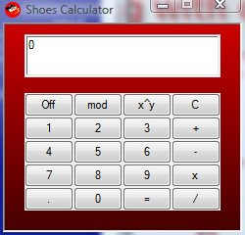
Interfacing with other classes
calc = Calculator.new
@numberbox = edit_line
@numberbox.text = '0'
@one = button "1”
@one.click {
@numberbox.text =
calc.key('1')
}
Methods of other classes need to pass back parameters to be displayed in Shoes
The graphic objects need to handle
Collection of data
Display of results
The other class definition provides the memory storage and processing

Slide 18
おわり The end

